Slide 1
8.40 m
1.20 m
4.80 m
1.80 m
y
x
z

Slide 2
sample point
1.20 m
1.80 m

Slide 3
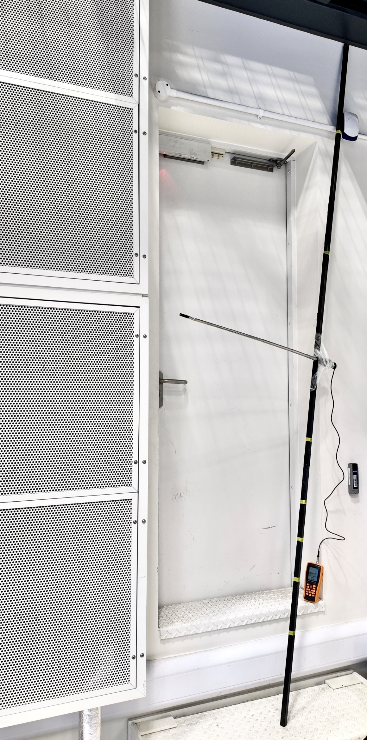

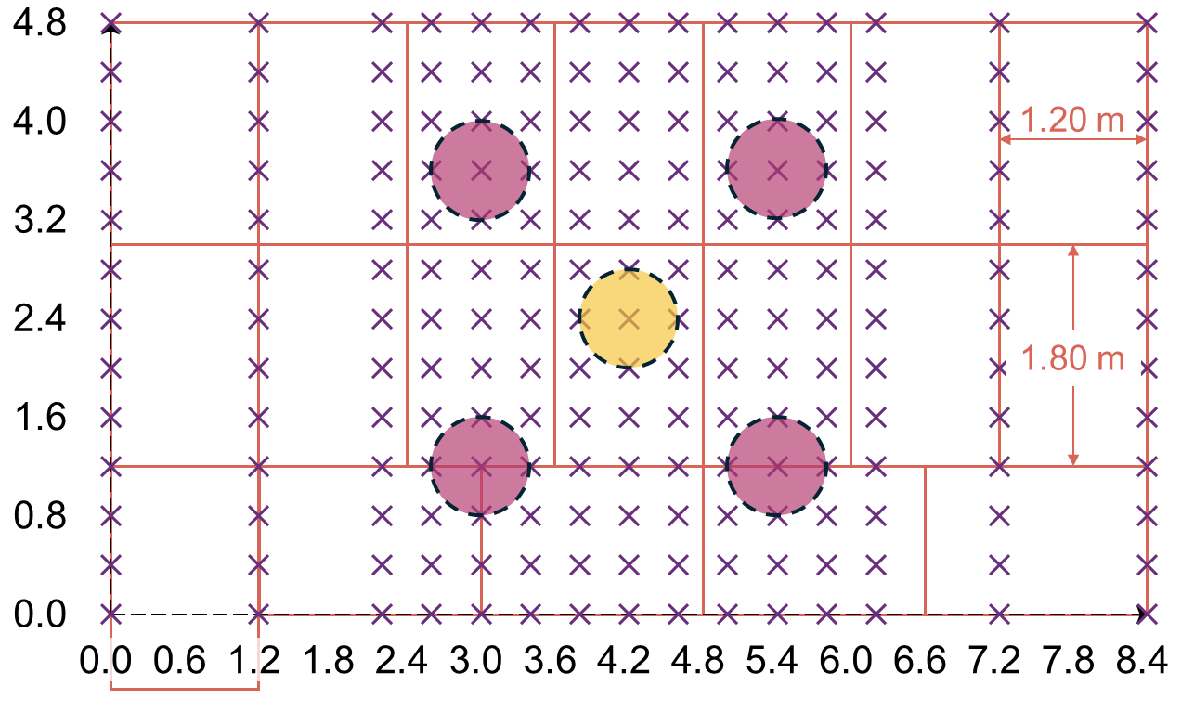
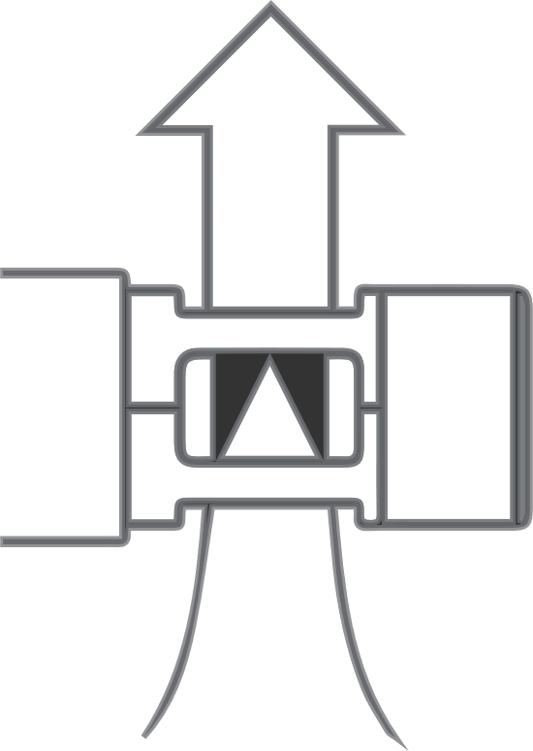
sample point
fibreglass reinforced tape
single-fan case
four-fan case
probe
y (m)
height-indexed
custom support
y
x (m)
constant-
temperature HWA
x
z

